Slide 1

The Lunar Meteoroid Engineering Model (LMEEM)
NASA MSFC Natural Environments EV44
Anthony M. DeStefano, Ph.D.
Lunar Surface Science Working Group
September 7, 2022

Slide 2
Overview
What is lunar meteoroid ejecta?
What are the meteoroid sources?
How is the cratering process modeled?
How are the meteoroid ejecta distributed from the crater?
How to track meteoroid ejecta to an observer/asset?
Summary and applications

Slide 3
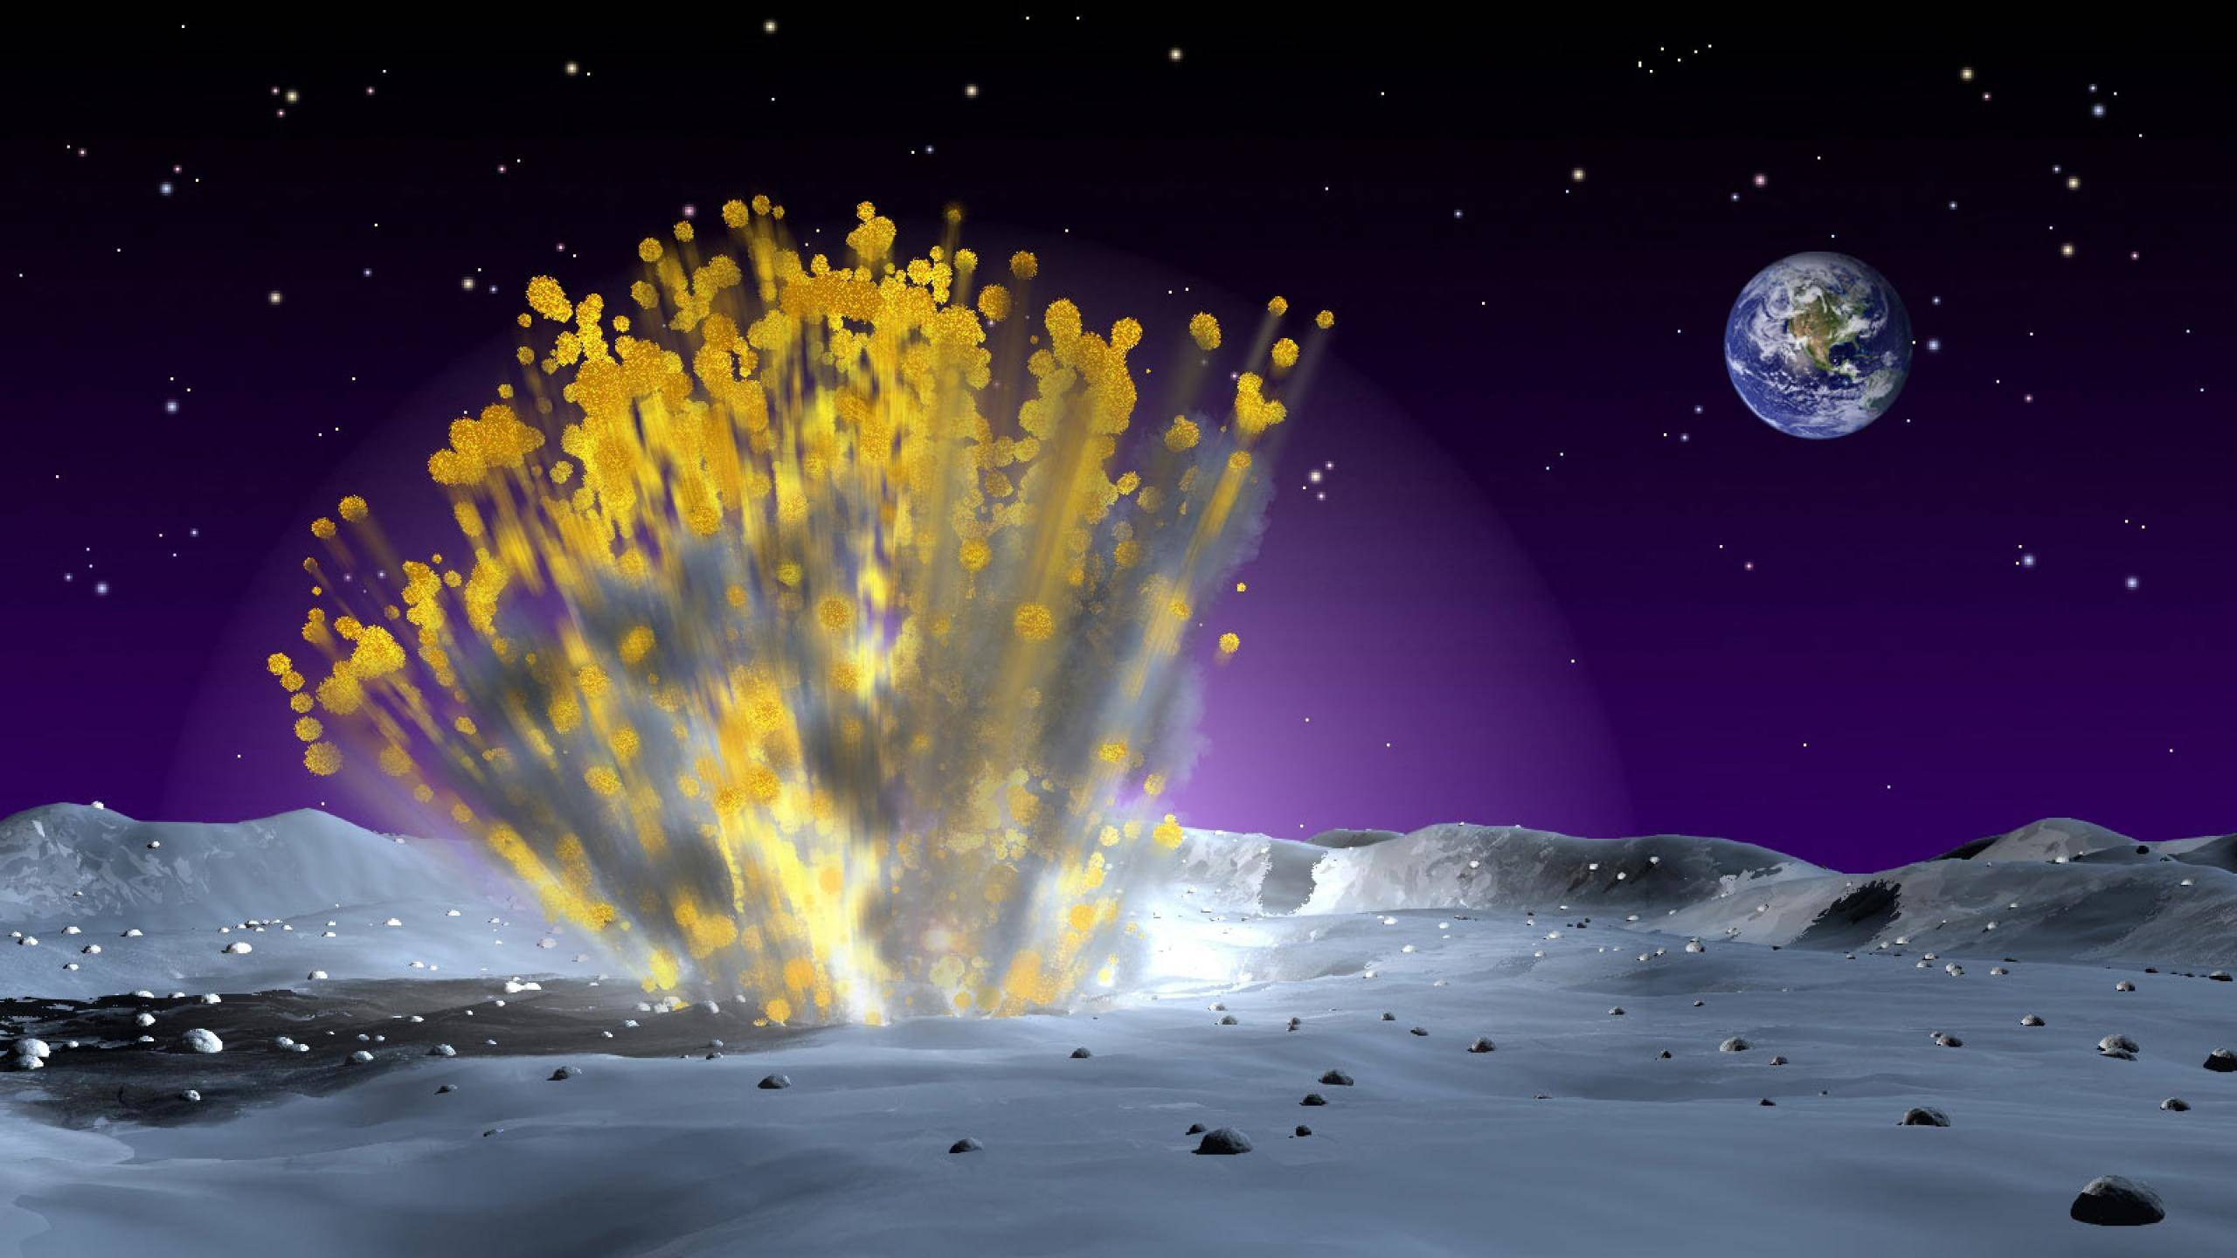
Lunar Meteoroid Ejecta
Image credit: NASA

Slide 4
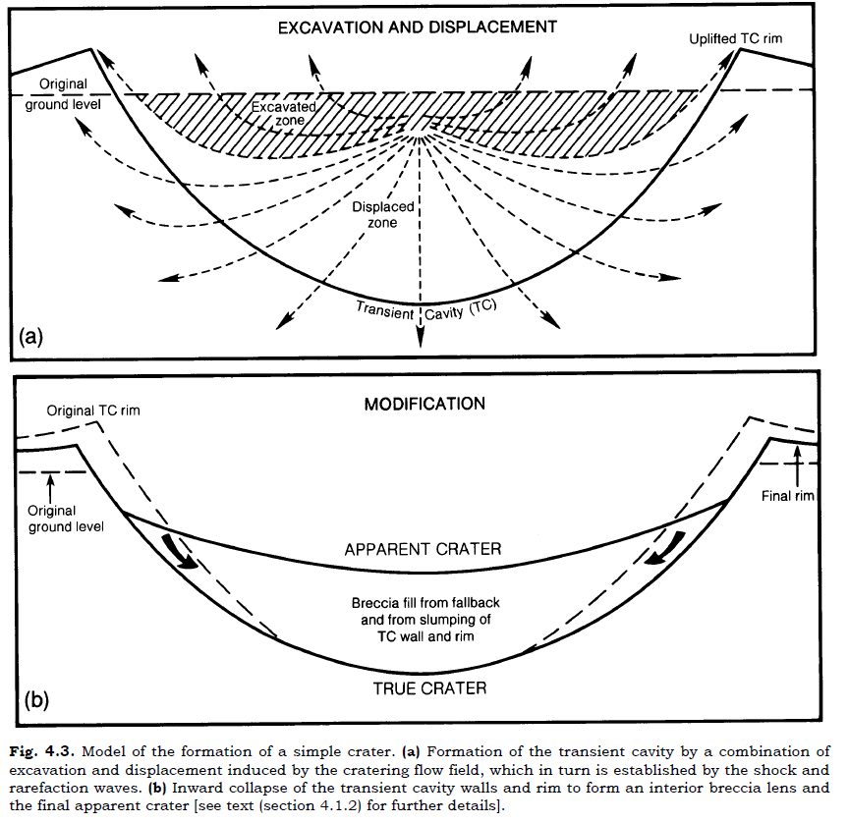
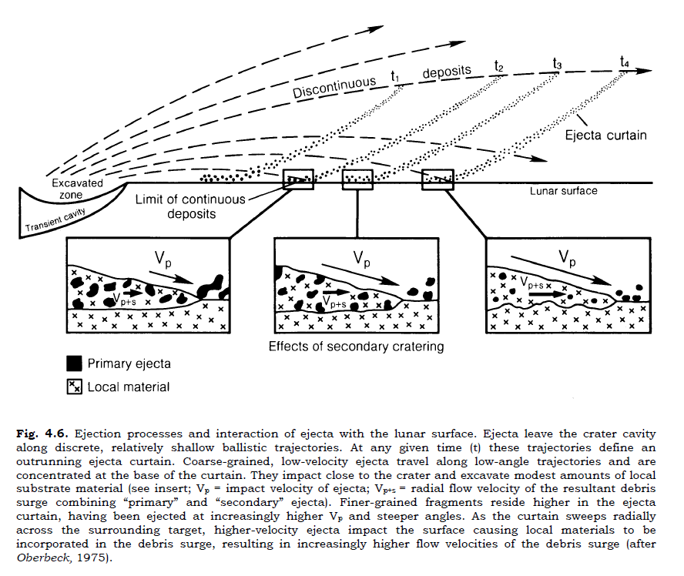
Crater formation and ejecta transport
Transient Crater (TC)
Lunar Sourcebook, Heiken et al. 1991

Slide 5
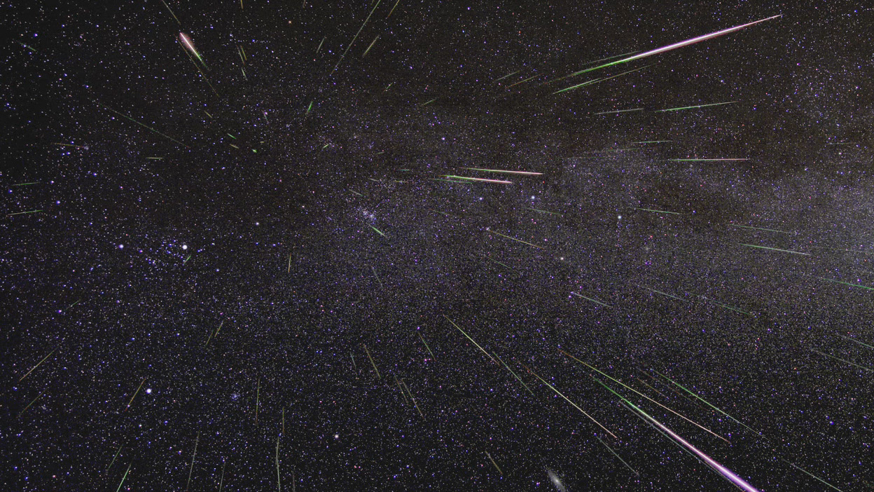
Meteoroid Sources

Slide 6
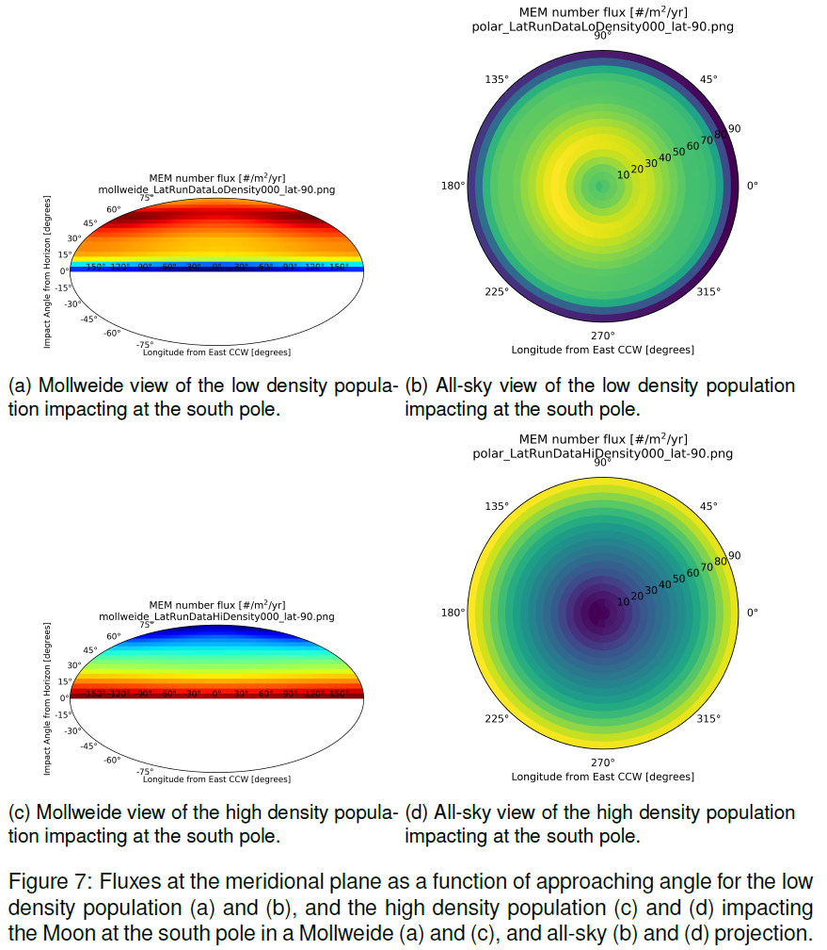
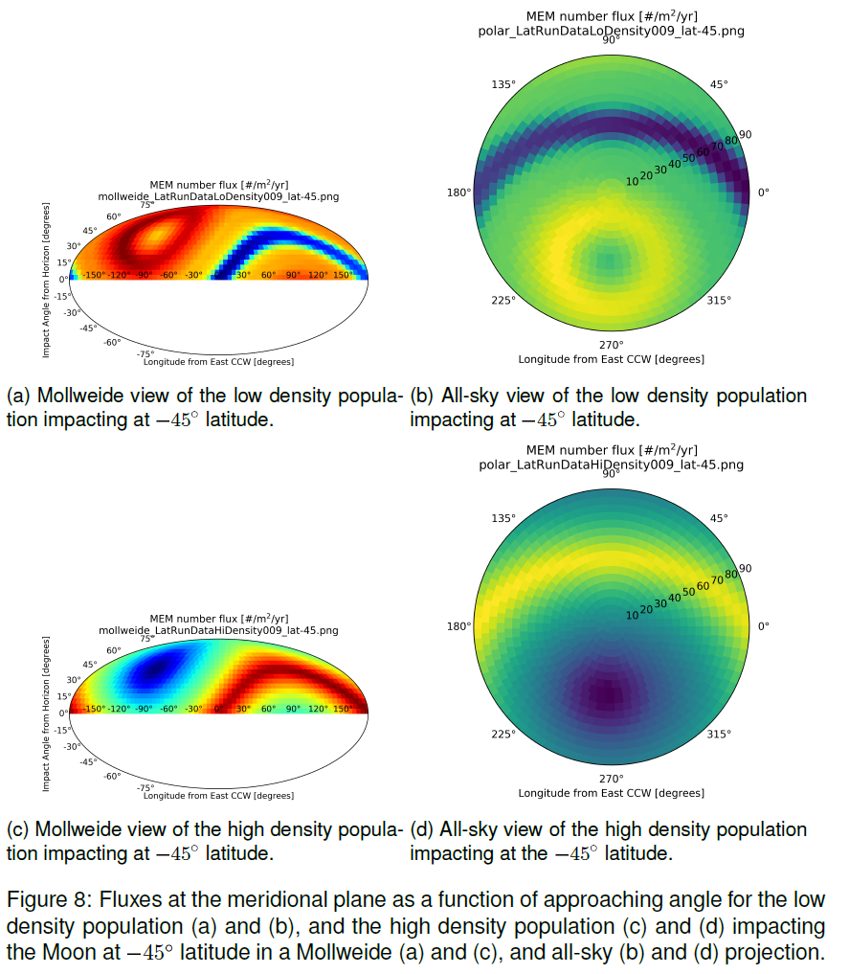
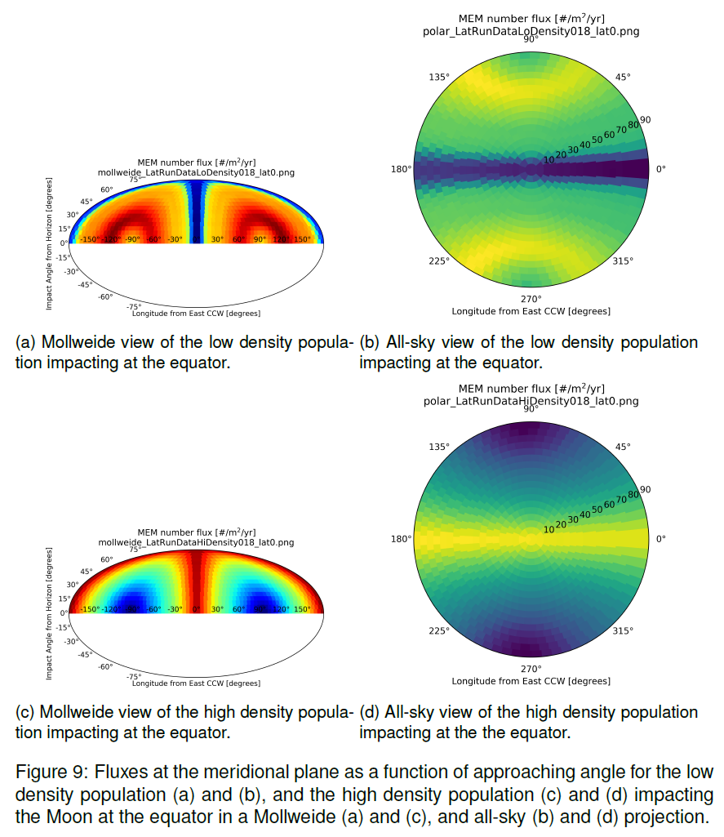
Sporadic Meteoroids as seen at the Moon
Apex and toroidal →
Helion/antihelion →

Slide 7
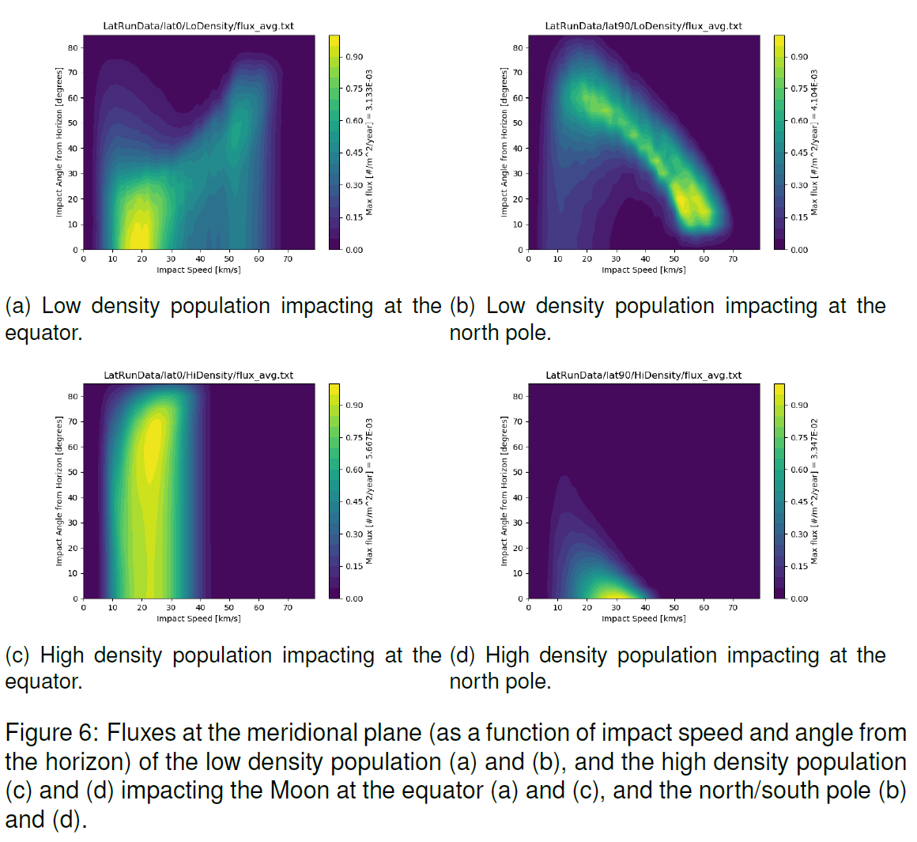
Impactor angle from horizon (deg) vs. impact speed (km/s)

Slide 8
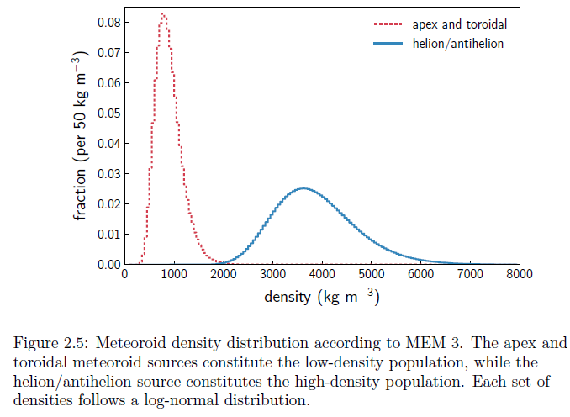
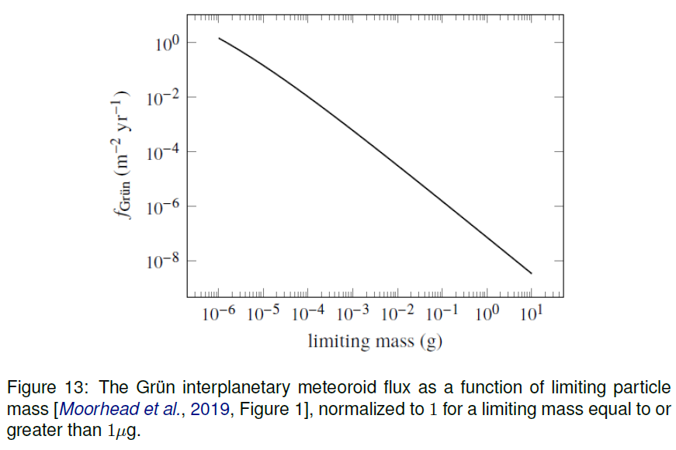
Density and mass distribution of sporadic meteoroids

Slide 9
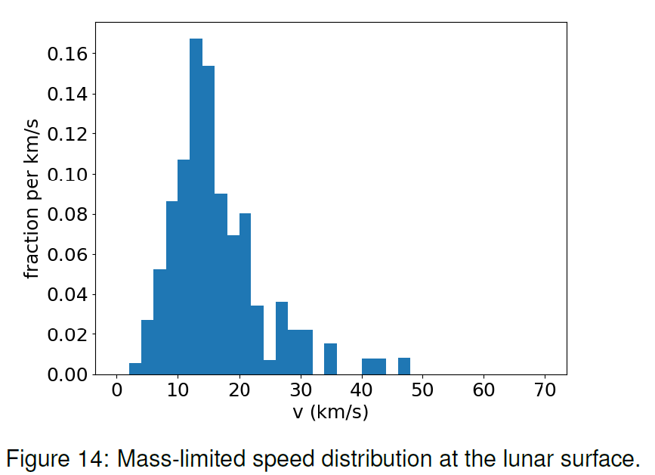
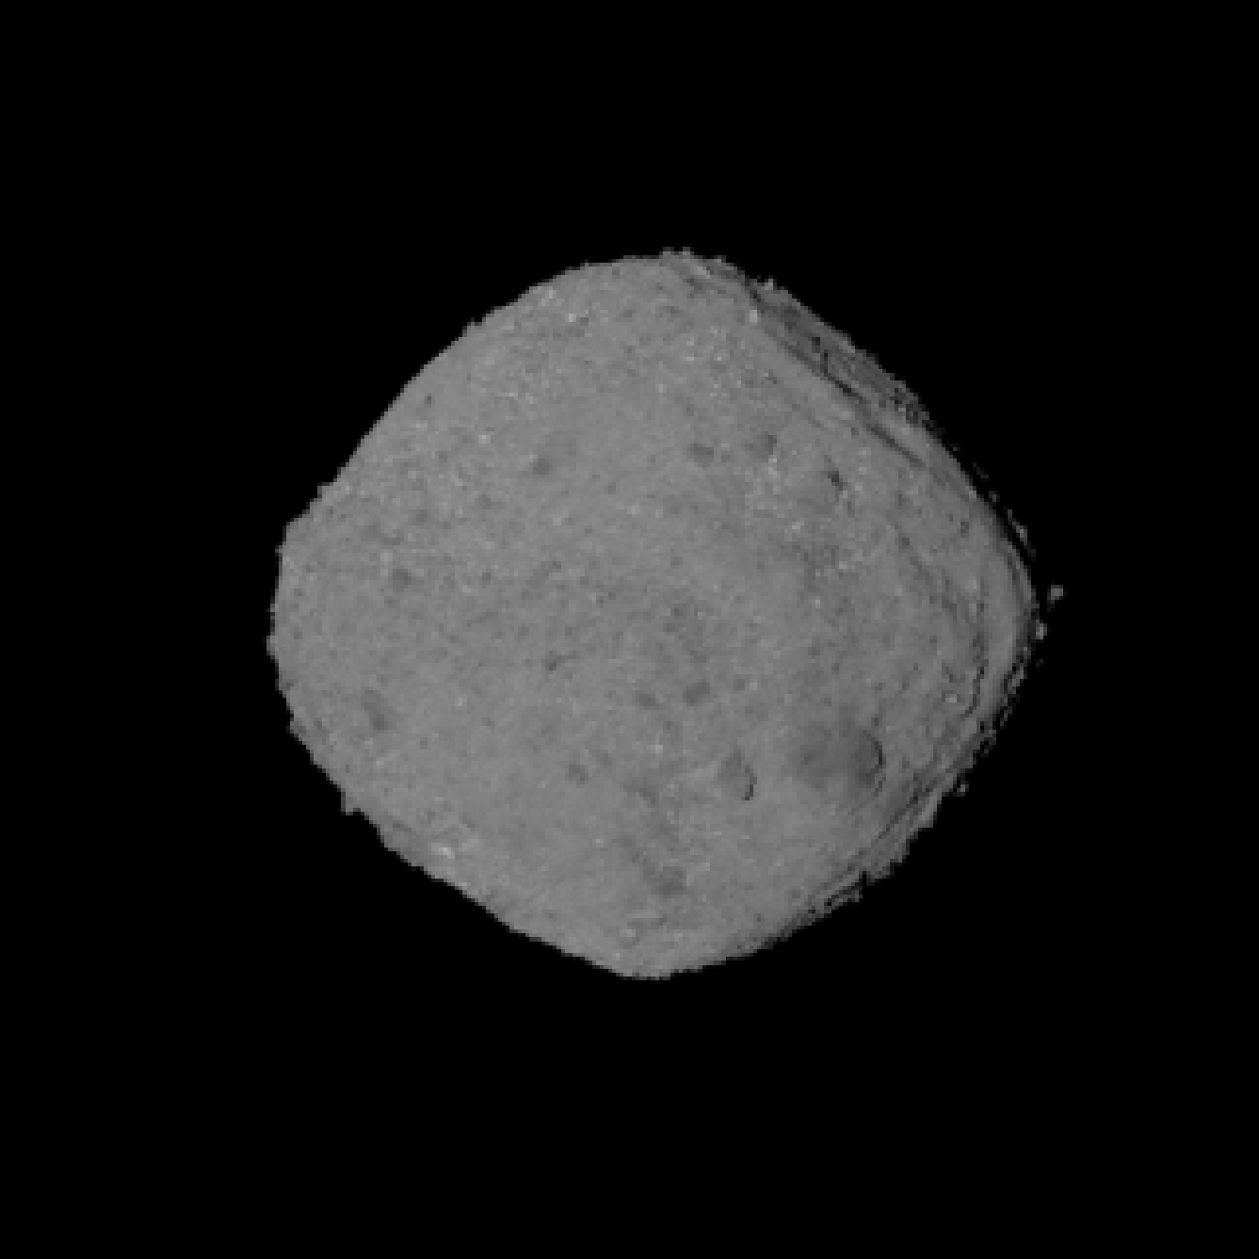
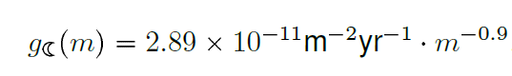
Near-Earth Objects: Speed and mass distribution as the Moon
OSIRIS-REx Sees Bennu from 'All Sides'
https://www.nasa.gov/image-feature/goddard/2018/bennu-from-all-sides

Slide 10
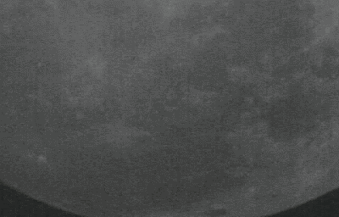
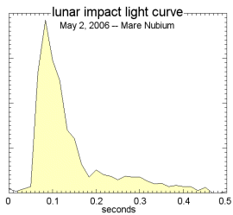
Meteor Showers: Watching an impact from Earth… May 2, 2006 A piece of debris from Comet Encke struck the plains of Mare Imbrium, making a crater about 3 meters wide.
https://www.nasa.gov/vision/universe/solarsystem/13jun_lunarsporadic.html
Video-recorded by MSFC engineers Heather McNamara and Danielle Moser (Meteoroid Environment Office)

Slide 11
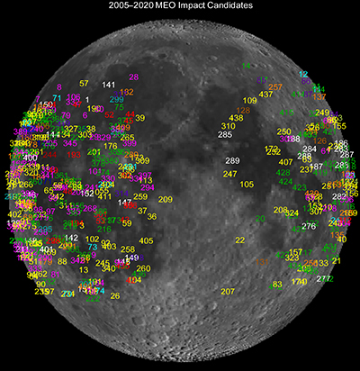
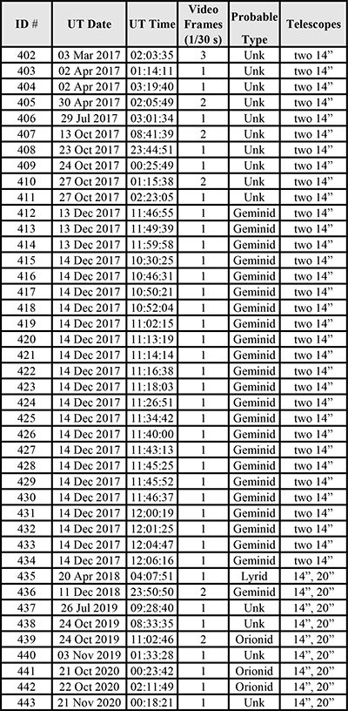
https://www.nasa.gov/centers/marshall/news/lunar/lunar_impacts.html
11

Slide 12
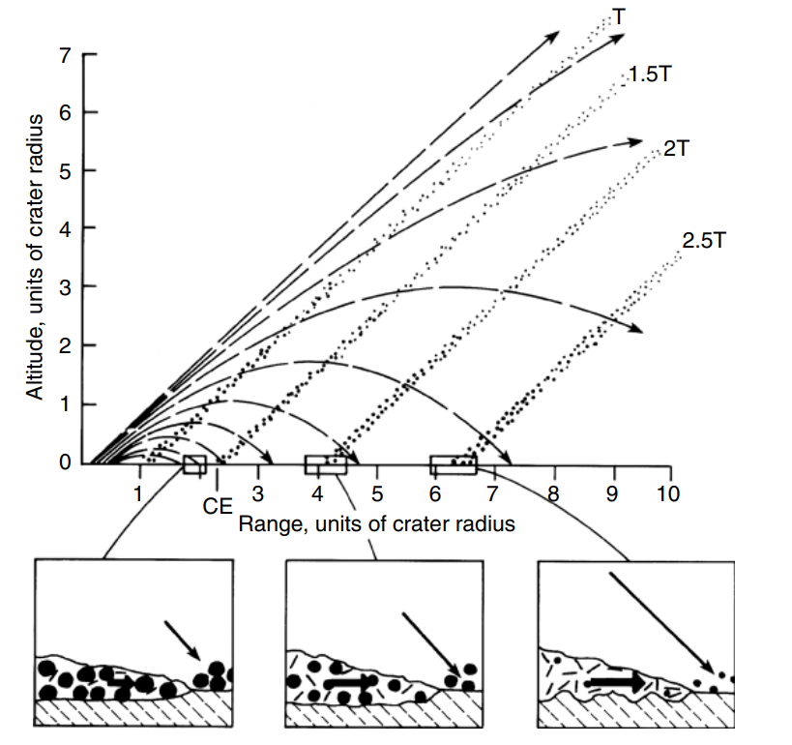
Modeling Ejecta from the Crater
Fig. 6.4, Impact Cratering, Melosh 1989

Slide 13
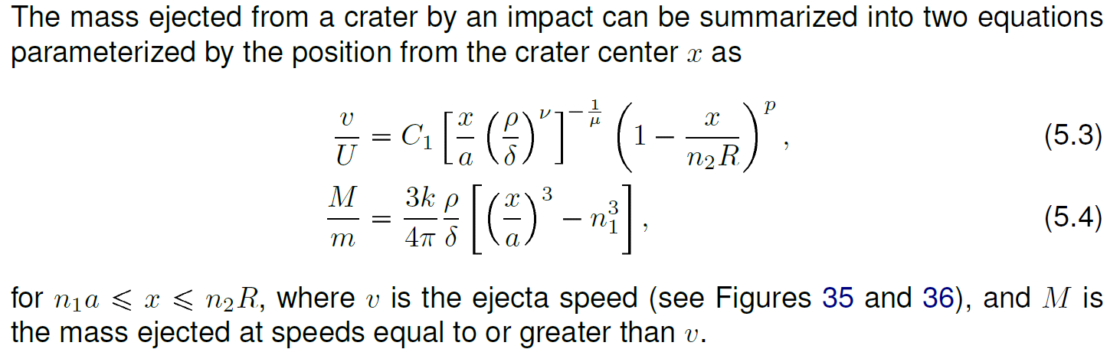
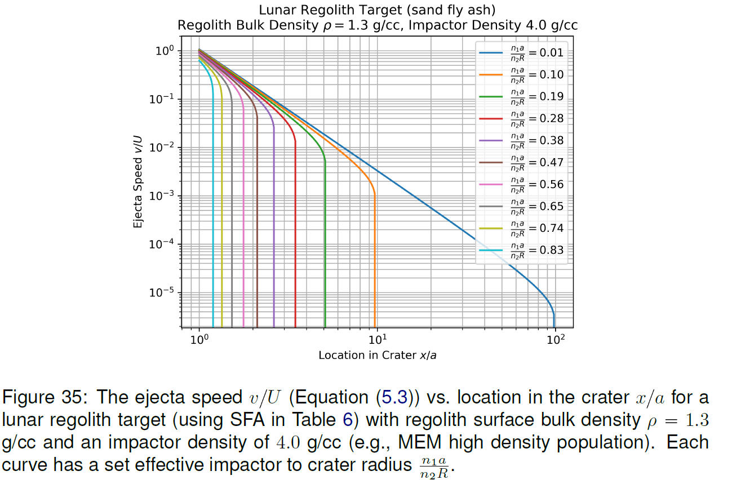
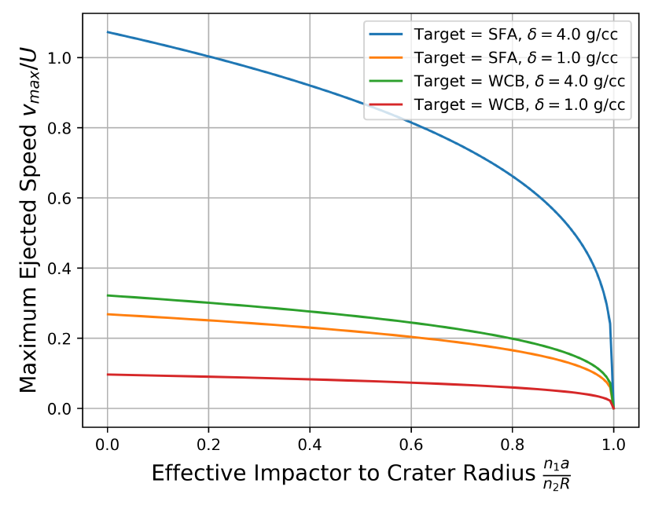
Scaling Laws: Housen & Holsapple 2011

Slide 14
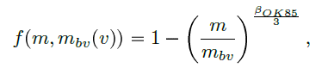
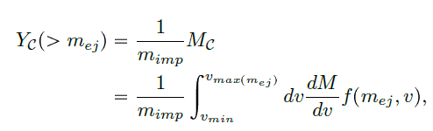

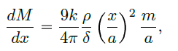
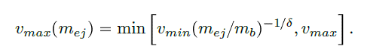
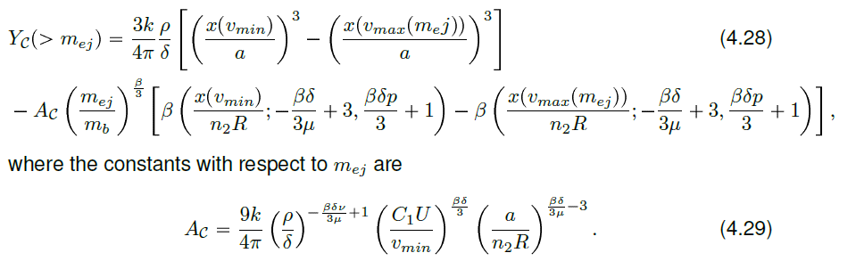

Meteoroid Ejecta Yield per crater (total ejected mass / impactor mass)
O’Keefe & Ahrens 1985
Housen & Holsapple 2011

Slide 15
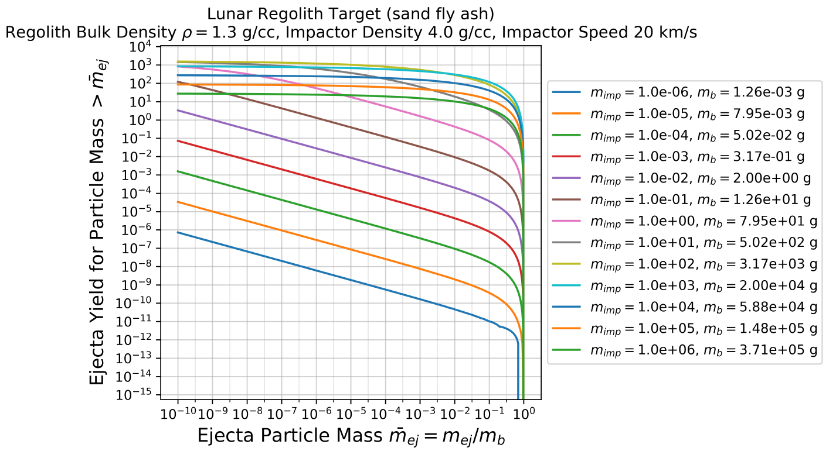
Example of Ejecta Yield vs. Impactor Mass

Slide 16
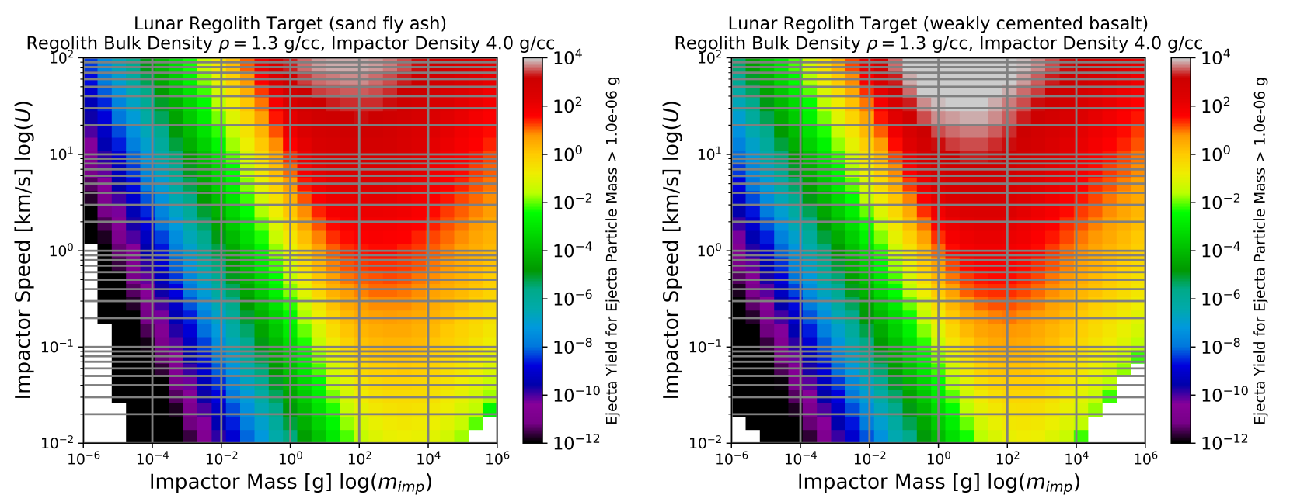
Ejecta Yield for fragments greater than a 10^-6 g

Slide 17
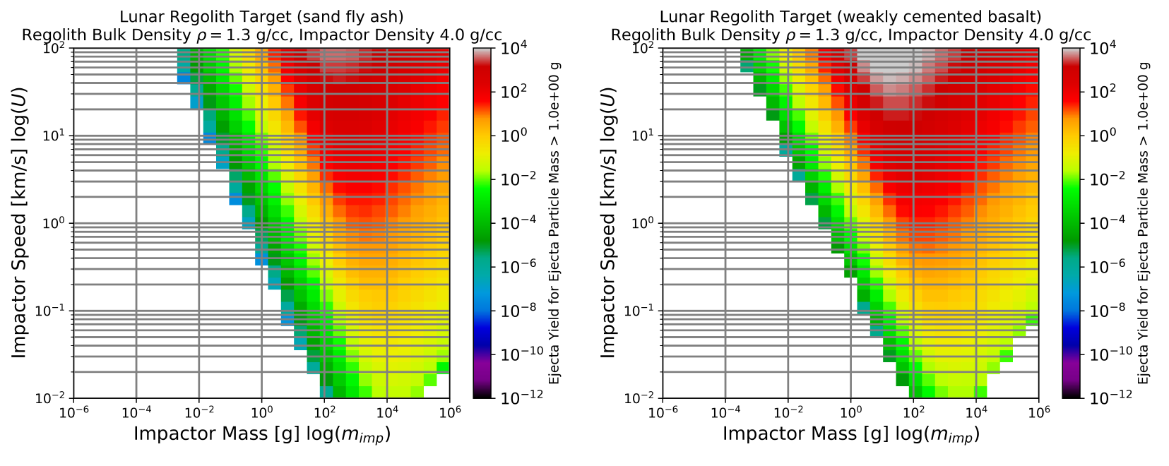
Ejecta Yield for fragments greater than a 1 g

Slide 18
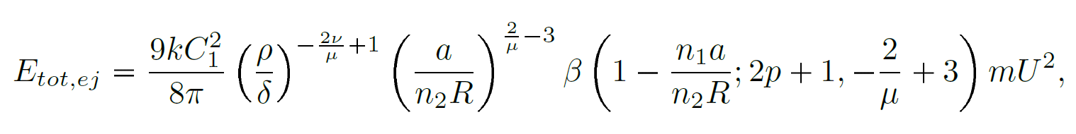
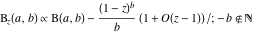
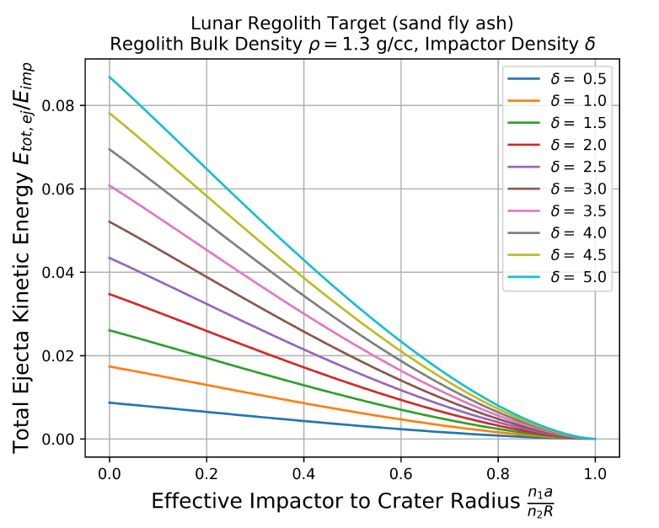
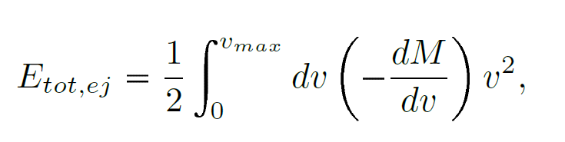
Total Kinetic Energy of Meteoroid Ejecta
https://functions.wolfram.com/GammaBetaErf/Beta3/

Slide 19

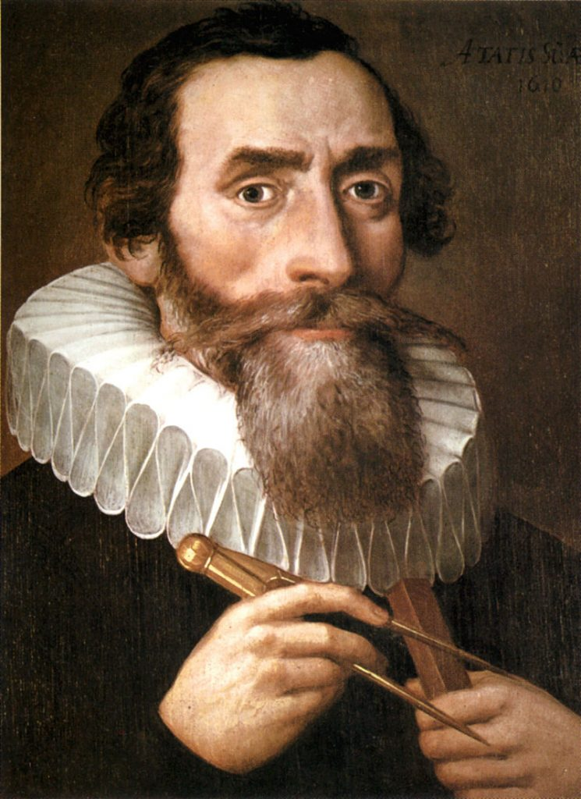
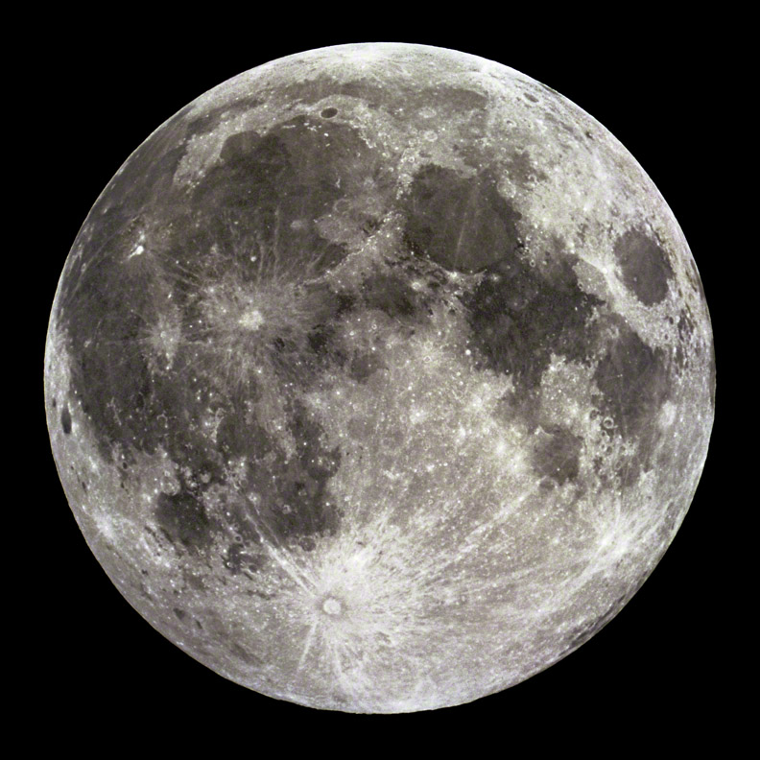
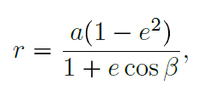
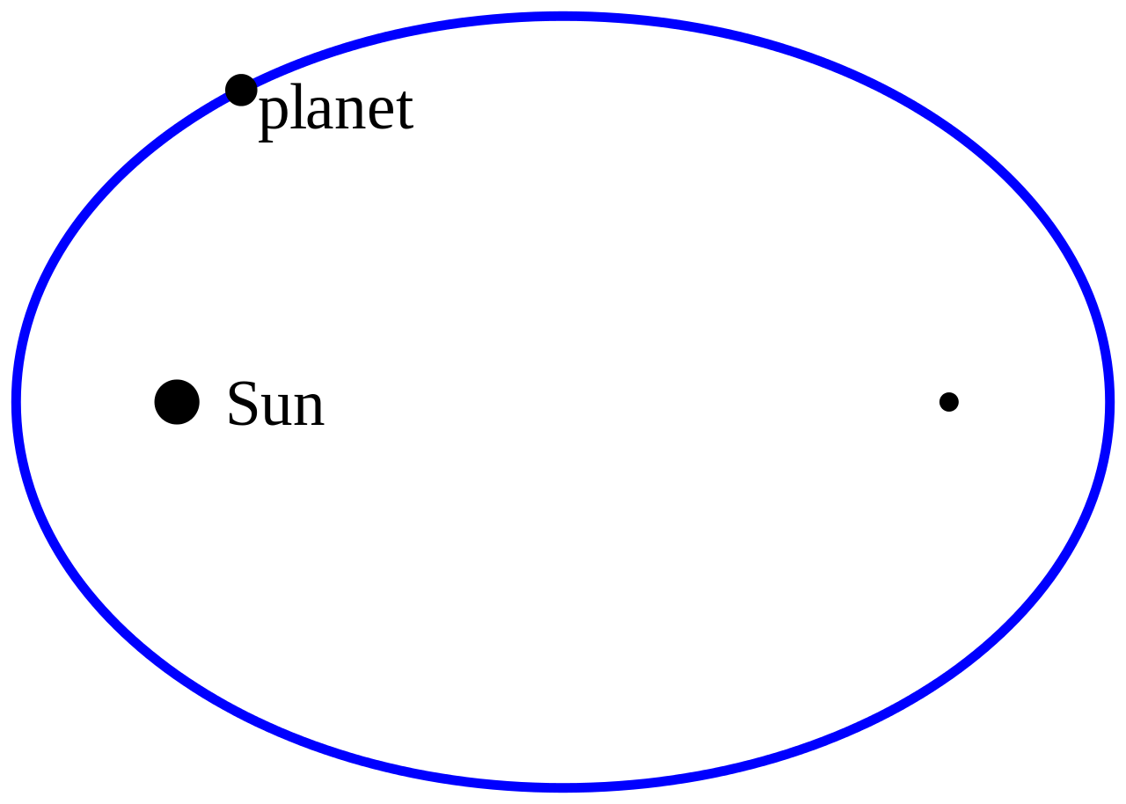
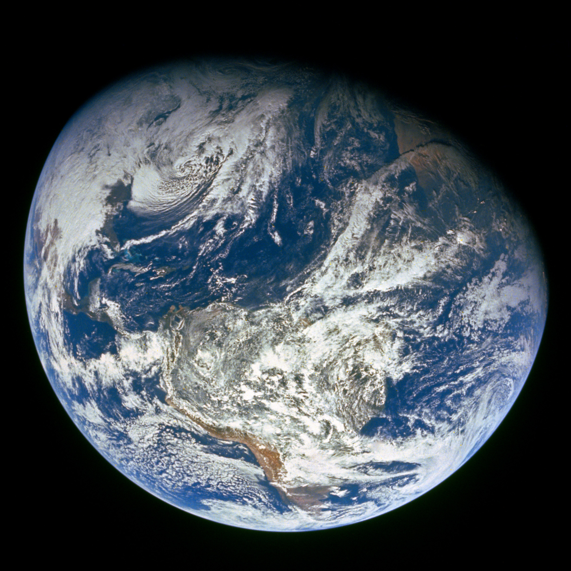
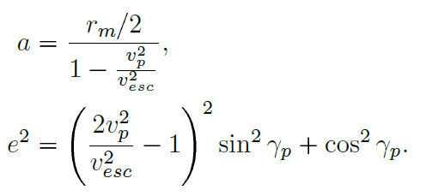
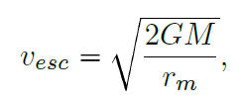
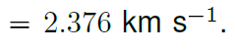
Tracking Ballistic Trajectories Analytically
Johannes Kepler 1571-1630
Phone a friend…
1st Law of Motion says: The orbit of a planet is an ellipse with the Sun at one of the two foci.
Not to scale
Semi-major axis
Eccentricity
Escape speed (e.g., Moon)

Slide 20
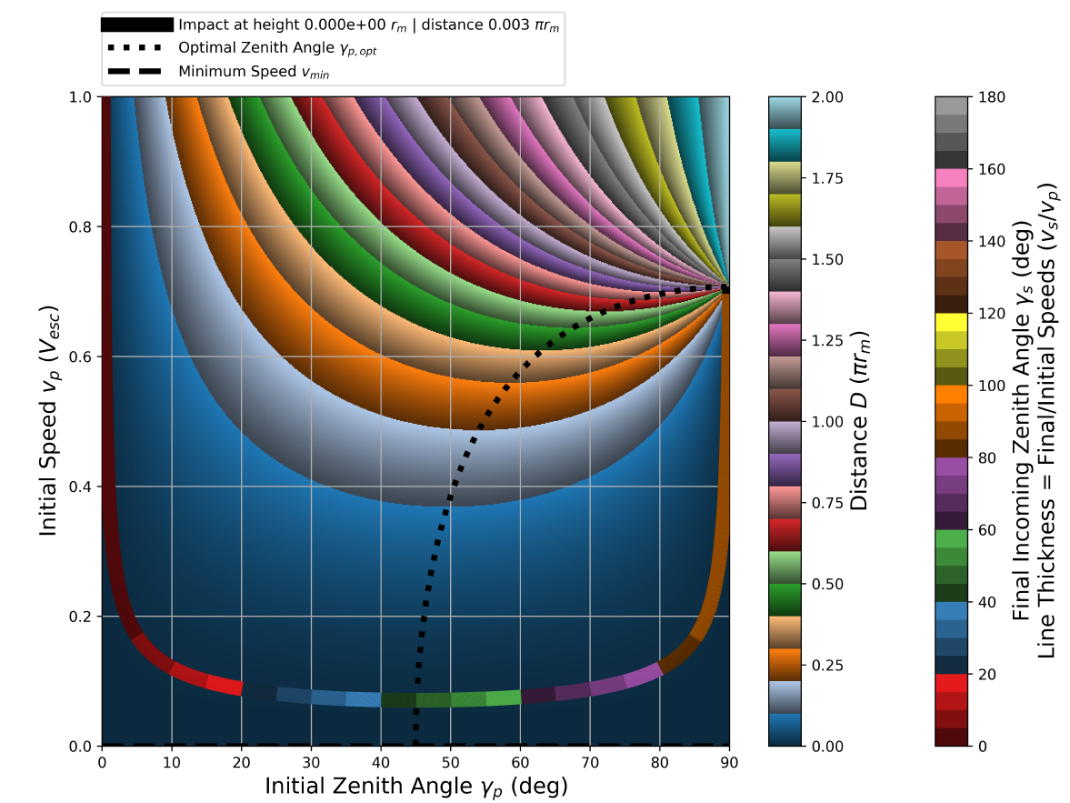
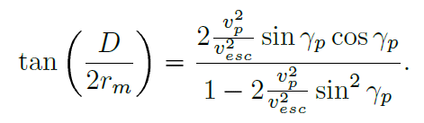
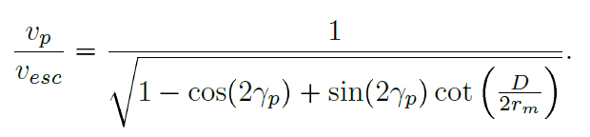
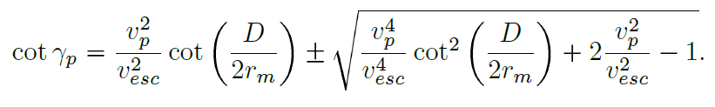
Tracking Ballistic Trajectories Analytically From crater back to surface
Distance from crater
Initial ejecta speed
Initial ejecta zenith angle

Slide 21
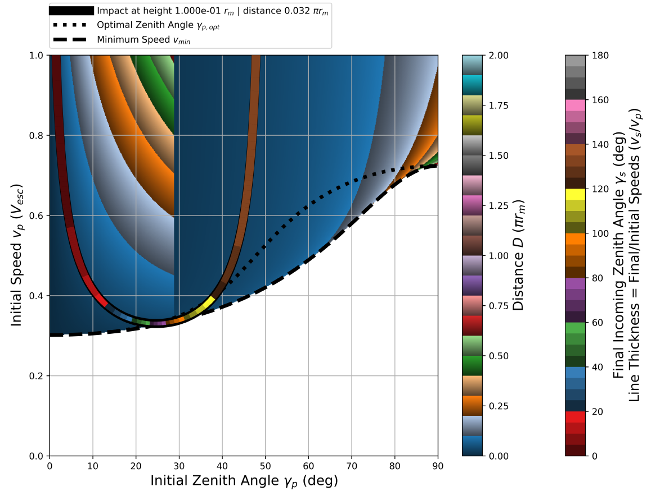
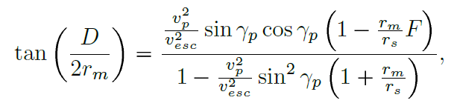
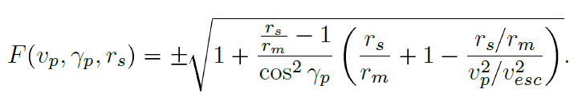
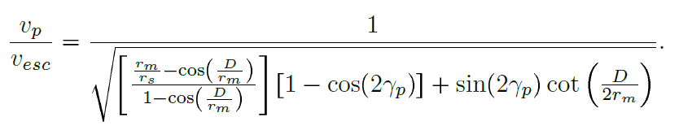
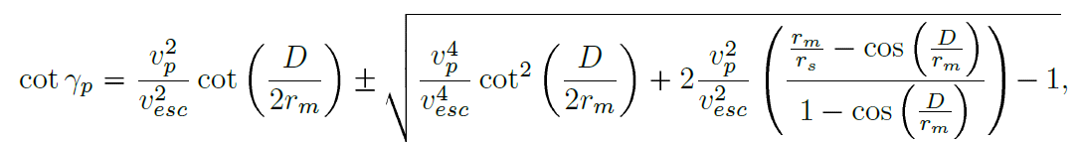



Tracking Ballistic Trajectories Analytically From crater to point above surface
Distance from crater
Initial ejecta speed
Initial ejecta zenith angle
Minimum initial ejecta speed
Final ejecta speed
Final ejecta zenith angle

Slide 22

Summary of LMEEM
Gone through a NASA Engineering & Safety Center (NESC) review, completed December 2021
Have been going through suggestions and feedback and had to develop a new refactored code
Sporadic meteoroid and near-Earth object sources
Meteoroid Engineering Model 3: Moorhead et al 2019
Mass flux: Grun et al 1985
NEO: Brown et al 2002, Moorhead 2020 (Memo)
Can include meteoroid showers on an as-needed basis
Scaling laws and ejecta distributions based on:
Scaling laws: Housen & Holsapple 2011
Size vs. speed fragment distribution: O’Keefe & Ahrens 1985
Fragment size distribution: Koschny & Grun 2001
Oblique impact dependence: Gault & Wedekind 1978
Zenith/azimuth distribution: Rival & Mandeville 1999, Miller 2017
LMEEM
https://ntrs.nasa.gov/api/citations/20220000562/downloads/20220000562FINAL.pdf

Slide 23


Design Specification for Natural Environments (DSNE) SLS-SPEC 159
Current lunar meteoroid ejecta model in DSNE is NASA SP-8013 (Cour-Palais 1969) – based on Zook 1967
Goal: Provide an update to DSNE’s meteoroid ejecta model with output from LMEEM

Slide 24



Applications
Human Landing System (HLS)
Gateway and Orion
https://www.teslarati.com/spacex-starship-moon-elevator-nasa-prototype/

Slide 25

Applications
Meteoroid ejecta environment size distributions as a function of speed directly flow into ballistic limit equation (BLE) calculations
Bumper risk analysis via Hypervelocity Impact Technology (HVIT) group at NASA JSC

Slide 26

Thank you for listening!
Questions?

Slide 27



